Slide 1

Time Series Clustering for Analysing Pedestrian Footfall Patterns
Yanhua Xu, Nick Malleson
University of Leeds

Slide 2
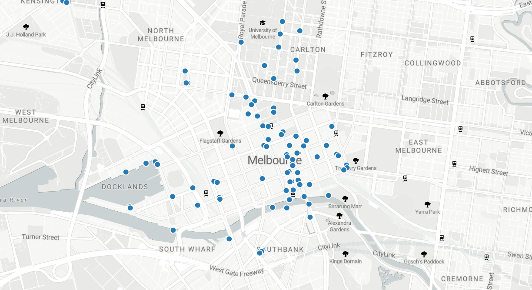



Introduction
Using clustering techniques to identify cameras with similar temporal profiles.
Data Collection
  Data sourced from Melbourne Open Data Portal.
  Temporal data collated from multiple sensors.
  Sensor count has been increasing annually.
  24/7 hourly monitoring of pedestrian traffic in both directions.
Some Key Questions
  How can we categorise sensors based on observed footfall patterns?
  What are the underlying footfall patterns in the city?
  What distinct pedestrian movement trends do these sensor groups reveal about Melbourne?
  How might specific events or factors influence the footfall patterns captured by these sensor groups?
Source: https://melbournetestbed.opendatasoft.com/pages/visualise-our-date/

Slide 3
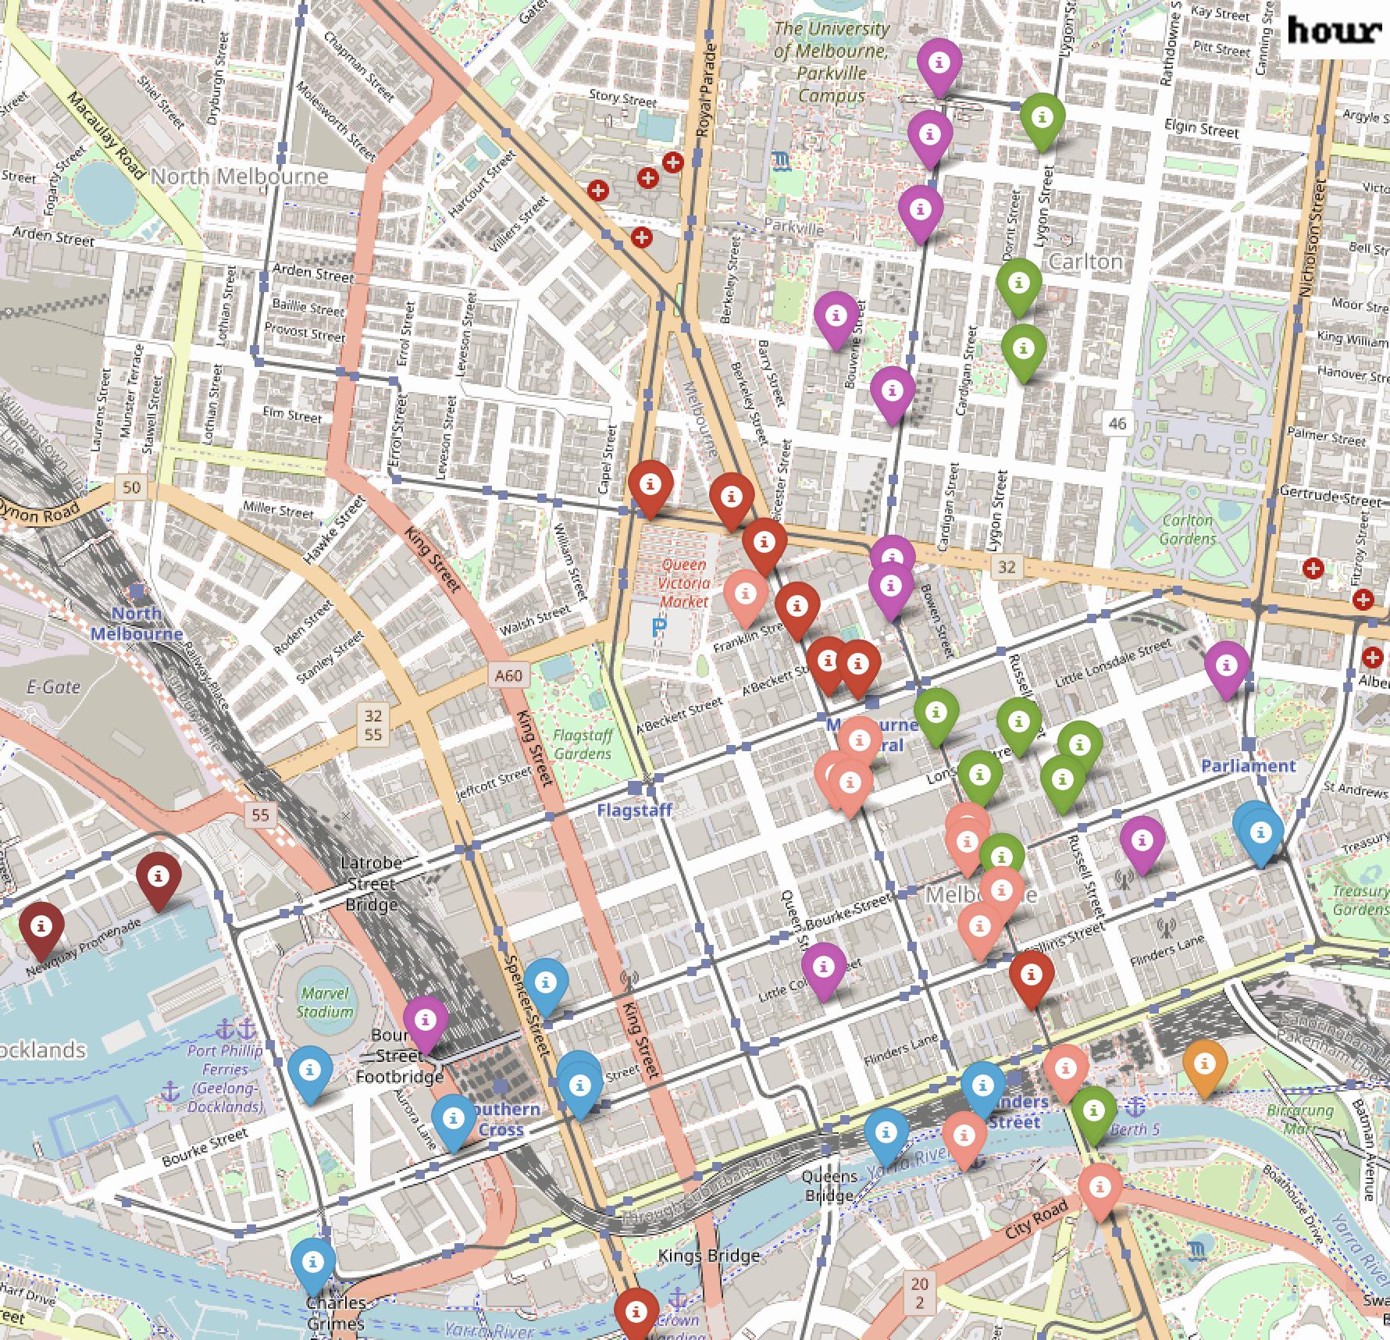
Time Series Clustering
Starting our analysis from 2019 data..
Employed DTW-KMeans to extract pedestrian patterns at various granularities: from hourly to monthly
Insights & Questions (Ongoing Research)
  Why do sensors in different locations capture similar footfall patterns?
  How can these patterns inform public transport schedules or roadworks planning?
  Are there any anomalies or unexpected patterns in footfall across different sensor clusters?
  How do footfall patterns change during special events or public holidays compared to regular days?
  How have footfall patterns evolved over time? Are certain areas seeing increased or decreased footfall year over year?
  Do different clusters correlate with specific types of urban areas, e.g., commercial districts vs. residential areas?

